Slide 1
Challenges of equity market development
Attila Toth
Capital & Financial Market Development Team
EBRD
Ohrid, 23 September 2022

Slide 2
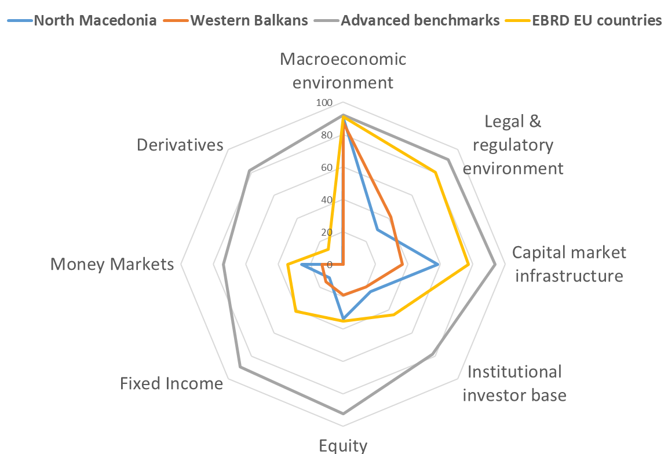
Capital market in North Macedonia
Financial Market Development Index (FMDI) – a 7-factor indicator developed recently by EBRD to measure the development of local capital markets in the economies in which the EBRD invests
Contextual indicators
Macroeconomic Policy and Stability of the Macroeconomic Environment
Legal and Regulatory Environment
Market Infrastructure and Access
Depth, liquidity and diversification of asset classes
Equity Market
Fixed Income Market
Money Market
Derivatives Market
North Macedonia clearly outperforms its natural peers, the Western Balkan countries in many aspects and it is steadily getting closer to the regional EU member markets
North Macedonia compared to peers and more advanced benchmarks

Slide 3
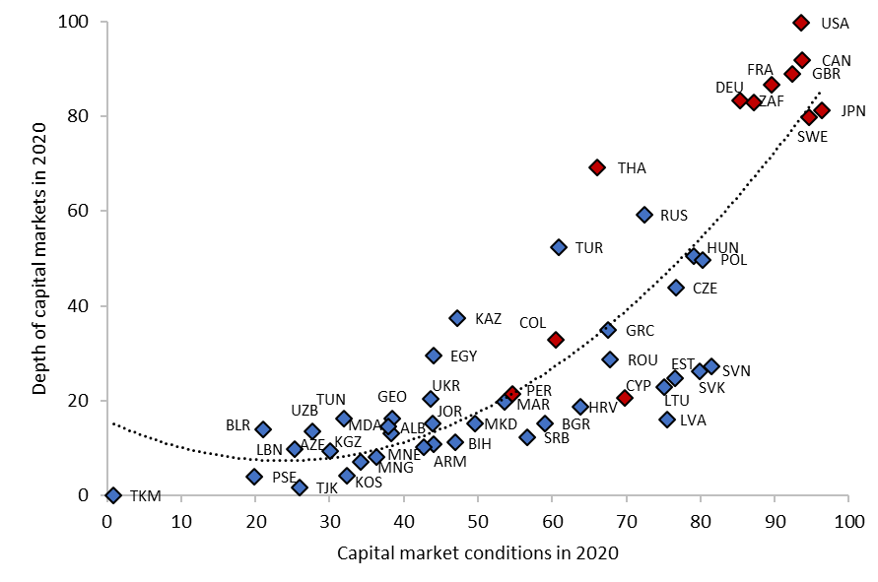
Depth of capital markets is closely linked to local conditions
In case of more developed markets financial market conditions (macro, legal & regulatory framework, market infrastructure, local investor base) tend to move together with the market depth.
Except in the case of the small Advanced Transition Countries
“Tyranny of size”: Smaller economies, including in Central Europe and the Baltics, tend to have lower market depth and liquidity for a given (high) level of supportive conditions
The aim should be to avoid the path of these smaller countries and follow the most developed ATC countries – Poland, Czech Republic and Hungary
Close, albeit imperfect, relationship between conditions for capital market development and market depth
Source: EBRD FMDI (2021)

Slide 4
The global perspective
The number of listed companies in the US and in the UK stock exchanges
IPOs across the globe have been facing a structural decline over the past 20 years, be it by the number of corporate transactions, by amounts raised or by market capitalisation.
For instance, the number of annual IPOs in Europe fell from 380 per year between 1997 and 2007 to 220 per year between 2008 and 2018.
The same trend is also happening in the US markets.
Then paradox of stock exchanges:
stock exchanges are bigger, more liquid and more efficient than ever before - but fewer and fewer companies are choosing to be listed on them or to use them to raise capital:
The value of stock markets in the UK and US has risen more than six-fold in real terms in the past 50 years and the value of trading in listed companies listed in the UK and US has increased by more than 50 times in real terms.
But the number of companies that are listed on stock exchanges in the UK and US has roughly halved over the past 25 years, the number of new listings has dropped by three quarters, and the amount of capital being raised on stock exchanges has dropped by around two thirds in real terms.

Slide 5
What is currently missing for the development of emerging markets
No issuer pipeline
Lack of corporate finance culture
Lack of knowledge about utilising capital markets
No willingness for opening up the shareholding structure and fear of any transparency
Lack of preconditions
Macro economic environment
Legal and regulatory framework
Market infrastructure and access to market data and information
Predictability of market operation
No intermediaries
No market size and liquidity
No investor base
Few local brokerage companies who would focus on the smaller issuers
No business case to provide research coverage and market making
Lack of large institutional investor base due to higher transaction costs and investment risks
Small local investor base, mainly retail and partly local institutional investors.

Slide 6
The timeframe of equity market development
Legal and Regulatory Environment
Market Infrastructure
Market Depth
1 year
3 year
5 year
10 year
The legal and regulatory environment as well as the capital market infrastructure can be developed relatively easily and quickly
Achieving real market depth takes decades

Slide 7
The challenge of awakening dormant markets
In almost all ATCs and many ETCs the task at hand is not to create a capital market from scratch but to relaunch the existing but not properly functioning market – which can be much more challenging because of the already lost trust
The vicious circle of dormant equity markets
The only solution to break the vicious circle is through a series of coordinated external intervention measures
Dormant market with poor liquidity and non-existent IPO market
No business case for investment service providers, consolidation and disappearance of independent ISPs
Insufficient or non-existent sales force towards issuers, non-existent service package
Capital market funding is not even a theoretical alternative for companies
Without supply the local investor base turns towards cross border trading
The local institutional investor base has no chance to strengthen in competition with international players
No trust towards the local capital market
Provision of showcases – IPO privatisation of SOEs
Co-investment schemes dedicated to IPO funding (with potential participation of IFIs)
Direct financial support to the stakeholders to cover the initial costs of market entry
Preferred regulatory treatment for public funding solutions (i.e. tax incentives)

Slide 8
EBRD’s equity market development approach
Assessment
Strategy and action plan
Targeted technical assistance
Infrastructure development
Deepening the investor base
Deepening the issuer base
Legal background
Improving trading and post trading services
Improving market access
Supporting local and cross border consolidation
Capital Market Accelerator Fund
Index reclassification
Research coverage
National Investment Fund
Building IPO pipeline through capacity building projects and targeted advisory support

